Slide 1


Quantifying Server Memory Frequency Margin and
Using It to Improve Performance in HPC Systems
ISAC 2021
Speaker：Yixin Luo (骆一鑫-S211000804)
November 25,2021
Notes:
量化服务器内存频率余量 并 将其用于提高高性能计算系统的性能

Slide 2
01
Background
02
Goal
03
Design
实事求是 敢为人先
04
Contributions

Slide 3
01
Background

Slide 4

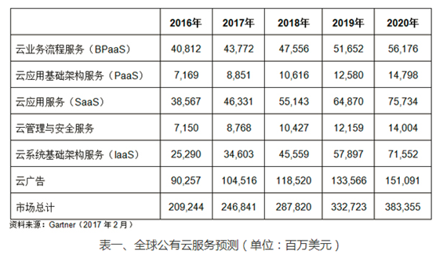
Chapter 1 Background
Cloud Servers is becoming prevalent
A growing number of companies
An increasing number of individuals
More and more money is being invested in cloud servers

Slide 5

Chapter 1 Background
Cloud Servers features
Cost saving
Flexible expansion
Easy maintenance
But need strong reliability

Slide 6
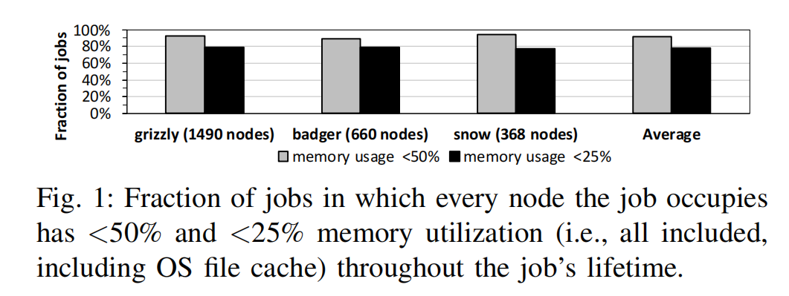
Chapter 1 Background
Conservative design of Cloud Servers
Resources are left unused
cpu utilization
Memory utilization
......
Hardware is underrated
Memory Latency
Memory Frequency
......
Notes:
作业占用的每个节点在整个作业的生命周期中具有<50%和<25%的内存利用率（即全部包括在内，包括操作系统文件缓存）。

Slide 7
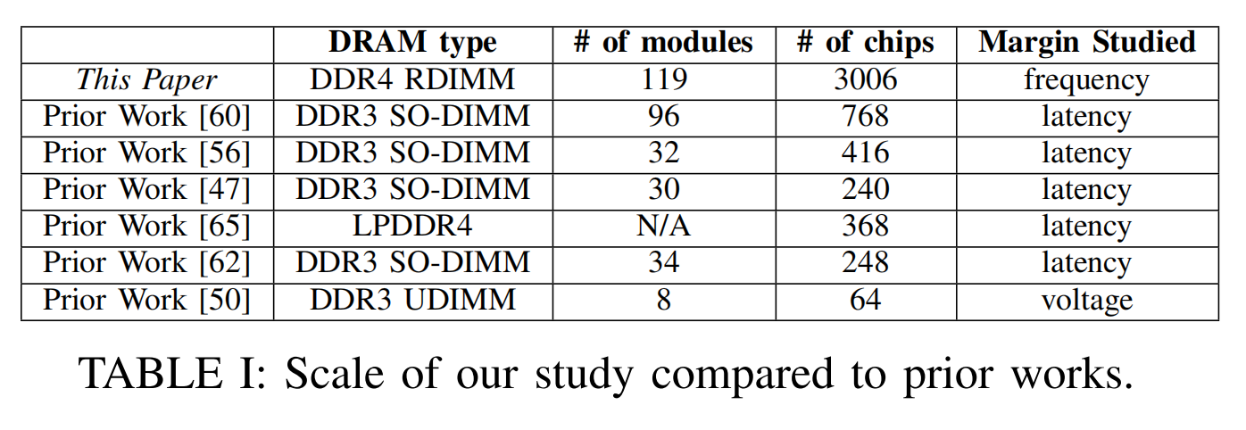
Chapter 1 Background
Release Memory of Cloud Servers
Reduce latency
Memory Power Management via Dynamic Voltage/Frequency ScalingMemory utilization
Design-Induced Latency Variation in Modern DRAM Chips: Characterization, Analysis, and Latency Reduction Mechanisms,
......
Increase frequency
Hetero-DMR (This paper) (The only one)
Memory frequency margin

Slide 8
02
Goal

Slide 9
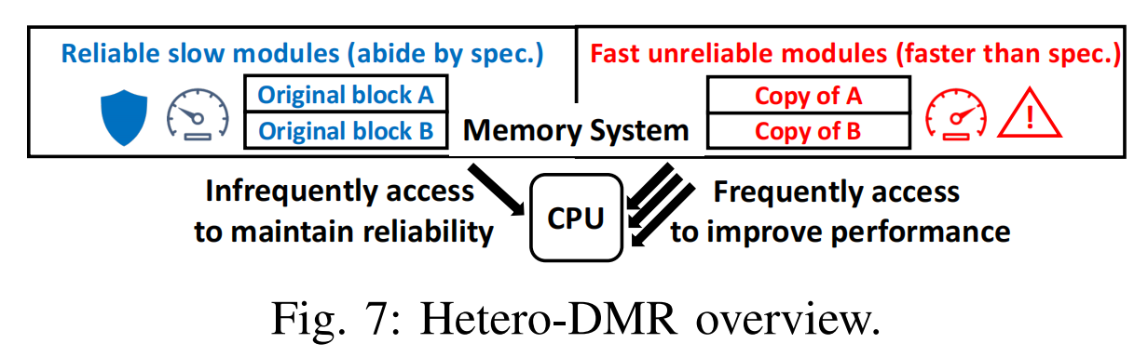
Chapter 2 Goal
Goal
Our goal is to enhance server memory systems to transparently operate faster than memory manufacturer specification while rigorously maintaining the same level of reliability as a system that always abides by specification.
Overview

Slide 10
03
Design

Slide 11
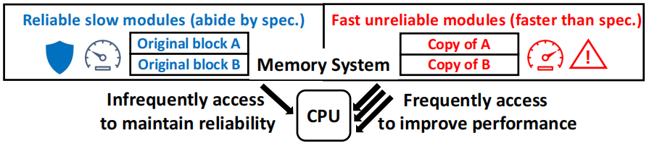
Chapter 3 Design
Challenge 1: How to Efficiently Keep Original Blocks Safe While Operating Copies Unsafely Fast
Different channels
Only half of the channels faster than spec
The cost of updating copies
Same channels
All channels have the opportunity to operate faster than spec
Eliminate all write bandwidth overhead to update copies
Notes:
两个设计方案
因为CPU通过总线互连拓扑连接到信道中的所有级别，众所周知，该拓扑支持在同一总线事务中将总线广播到总线上的多个组件

Slide 12
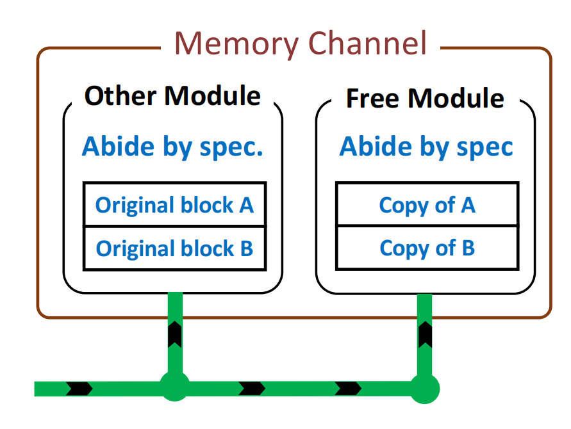
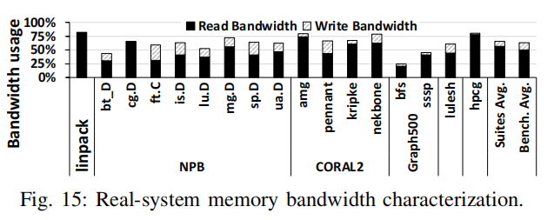
Chapter 3 Design
a.How To Keep Original Blocks Safe and fast When a Channel is in Write Mode
Reliability
Abide by spec (Write Mode is no acceleration but the percentage of writes is very small )
Round-trip latency from read to write and back
Today’s DRAM: 20ns,batch:128
Hetero-DMR:1us,batch:100x128
Notes:
因为CPU通过总线互连拓扑连接到信道中的所有级别，众所周知，该拓扑支持在同一总线事务中将总线广播到总线上的多个组件

Slide 13
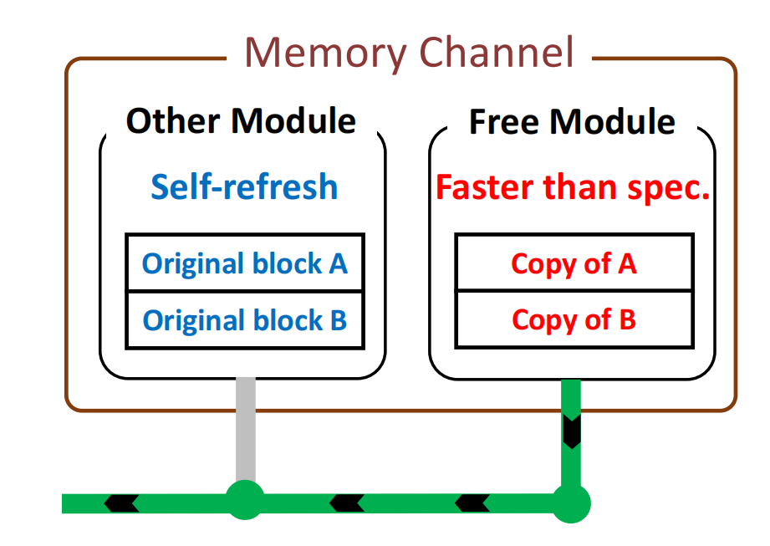
Chapter 3 Design
b.How to Keep Original Blocks Safe and Faster When a Channel is in Read Mode
Reliability
Only read the free module
Speeds up the channel’s frequency
Higher frequencies lead to better performance
Need self-refresh

Slide 14
Chapter 3 Design
Challenge 2: How to Quickly and Reliably Detect Errors in Copies Caused by Unsafely Fast Read Mode?
Check method^{[1]}
Parity Check
Cyclic Redundancy Check(CRC)
Error Correcting Code(ECC)
Hetero-DMR
Bamboo-ECC^{[2]}: uses all 64 data bytes in a memory block to compute eight Reed-Solomon ECC bytes together
[1]https://blog.csdn.net/Nightya/article/details/106311314
[2]J. Kim, M. Sullivan, and M. Erez, “Bamboo ECC: Strong, safe,and flexible codes for reliable computer memory,” in Proceedings of HPCA’15, 2015.
Notes:
奇偶校验(Parity Check)
奇偶校验只能够检测错误，无法纠正错误，并且由于其原理特性，无法检测双位错误。
CRC校验(Cyclic Redundancy Check)
循环冗余校验（CRC）具备检错和纠错的能力（其由信息码n位和校验码k位构成），其校验可以理解为一种二进制模2算法，。CRC校验会占用较多CPU，效率不是很高。
ECC校验(Error Correcting Code)
ECC 校验能纠正单比特错误和检测双比特错误，但是对 1bit 以上的错误无法纠正，2bit 以上的错误不能检测。从这个角度来看，当系统报多bit错误的时候系统可能会挂掉就不奇怪了，因为纠不回来嘛，但是实际上这也是软件设置的问题，毕竟只是几个数据的错误一般也不会造成系统瘫痪，更多的是一种自我保护机制，万一是硬失效，那不就GG了。

Slide 15
Chapter 3 Design
Challenge 2: How to Quickly and Reliably Detect Errors in Copies Caused by Unsafely Fast Read Mode?
If Hetero-DMR wants to meet an SDC^{[1]} in a billion years
Bamboo-ECC can compute eight Reed-Solomon ECC bytes^{[2]}
P1 = 1/(2^(8*8)) :SDC probability
x :Let x be the number of errors encountered per hour
t :Let t be the number of hours in a billion years
P1*x*t=1
==》
SDC:The data read is not the same as the data stored
[2]J. Kim, M. Sullivan, and M. Erez, “Bamboo ECC: Strong, safe,and flexible codes for reliable computer memory,” in Proceedings of HPCA’15, 2015.

Slide 16
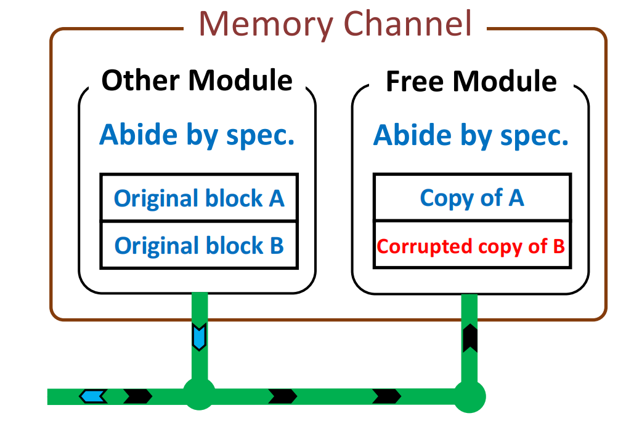
Chapter 3 Design
Challenge 3: How to Correct Errors?
Normal errors
ECC
Errors by faster frequency
Read the original block

Slide 17
04
Contributions

Slide 18
Chapter 4 Contributions
Contributions
first study to characterize frequency margins
first to explore how to rigorously maintain system reliability when operating memory faster than spec.Read the original block
System-wide simulations show Hetero-DMR provides 1.4x average speedup on job turnaround time over a conventional HPC system.
We also emulate Hetero-DMR on a real system and find closely matching performance benefit as our simulations
Notes:
•我们进行了第一个研究来描述频率公共域中的服务器内存模块的空白
•当操作内存比规格更快时的可靠性,我们首先探索如何严格维护系统
•系统范围的模拟表明，Hetero-DMR提供工作周转时间平均加速1.4倍传统的高性能计算系统。
•我们还在一个真实的系统上模拟Hetero-DMR，并发现与我们模拟的性能优势紧密匹配。

Slide 19
Thanks for watching

